Slide 1
Economics
Week #7

Slide 2
Topics of Week #7
Perfect Competition
Economic Profit
Profit Maximization*
Shut Down/Entry & Exit Decisions*
Short-Run & Long-Run Market Supply
Long-Run Market Equilibrium*
SR & LR Analyses*
"*" Indicates the most important topics.
Mateer and Coppock: Chapter #9

Slide 3

Perfect Competition
Perfectly Competitive Markets
Many buyers and sellers
Similar (if not identical) goods
Free entry and exit
Firms are price takers
Each firm has a very small market share.
Firms are unconcerned about their competitors' marketing or production decisions.
Information is freely available.
Price taker
Has no control over the market price.
"takes" the price as given.
Competitive firm is price taker.
Notes:
With perfect competition, we often draw two graphs. We draw the MARKET graph to show how the price is determined by the market forces of supply and demand. Then, we draw the FIRM graph to show how a firm takes that price as given, and how much it produces (based on its cost structure).
Free entry and exit is very important in competitive markets—it assures that economic profits will go to zero in the long run.
If there are hundreds of sellers and identical products, and anyone can enter the market, prices of goods will converge.

Slide 4


Are these Markets Really "Perfectly" Competitive?
Example | How It Works | Reality Check
Stock market | Buyers and sellers have real-time information about prices. Most of the traders make up only a small share of the market. | Large institutional investors are big enough to be able to influence the market price.
Farmer's markets | Sellers are free to come and go without having to pay a fee. Many buyers are also present. The market price for similar products will converge to a single price. | Many produce markets do not have enough sellers to achieve perfect competition. Higher- quality produce sellers can set their prices higher.
Notes:
Often, perfect competition is a market structure taught in economics courses, and one of the four examples above is used as an example of a perfectly competitive market with identical products and prices, as well as perfect information and free entry and exit.
However, in reality, each of these markets is not quite perfectly competitive.
Top row:
An example of a large institutional investor is PIMCO (Pacific Investment Management Company)

Slide 5
Economics in Two and a Half Men
"Two and a Half Men"
Alan tries to earn money by entering the competitive industry of personal massage.
Notes:
Economics in the Media
Lecture tip:
The clip mentioned on the slide can be found in the Interactive Instructor's Guide. Access the direct link by clicking the icon in the PowerPoint above.

Slide 6
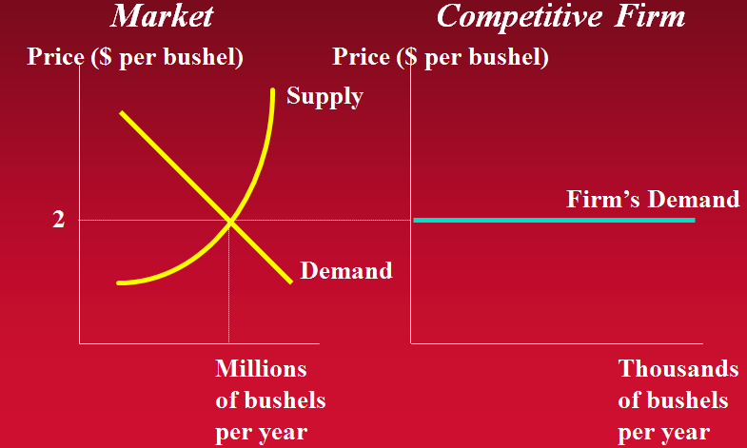
Market vs. Perfectly Competitive Firm
Notes:
In a perfectly competitive market the number of sellers depends on the profitability of selling the product. Free entry and resources ensure that the number or sellers, and therefore market supply, will increase when it is profitable to sell a product in a market. The key idea underlying the notion of perfect competition is that individual firms react to market rather than influence the prices of the products they sell.

Slide 7

Production and Profits for the Firm
Goal of a firm:
Maximizing profits
This is true whether the firm is competitive or not.
A profit maximizing firm needs to consider
Revenues.
Costs.
Notes:
Consider the Mr. Plow business.
He earns revenues from clearing snow. Customers pay him.
However, he has costs as well (gas, rent on vehicle, opportunity cost of his time)

Slide 8
Economic Profit
Total Revenue (TR)
TR = P x Q
Total Costs (TC)
Sum of all production costs at a certain level of output.
Total Profit (π) ➔ Economic Profit!
π = TR - TC
Notes:
The goal of a firm (competitive or not) is to maximize profits.
TR = P * Q.
Profit is denoted by the Greek letter pi.

Slide 9
Total, Average, and Marginal Revenue
Note that since the price is given to the competitive firm, it can only change the quantity produced to influence its revenue.

Slide 10
Total and Marginal Cost
Remember:
Total Cost = Total Variable Cost + Total Fixed Cost
Both Explicit and Implicit Cost are considered.
Marginal Cost

Slide 11
Profit Maximizing Rule in General
Profit is maximized by choosing the level of output such that
MR = MC
(The main "profit maximizing rule" for any type of market)
If MR > MC
The firm can increase profits by producing more Q.
If MR < MC
The firm has produced "too much" Q, and profits are not maximized.
Notes:
Recall that in economics, the optimal condition is often setting marginal something = marginal something else.
Marginal analysis: here, we are looking at one output unit at a time and inspecting the costs and revenues associated with that one unit of output.
Where does MR = MC come from? Think about the intuition of cleaning an additional driveway.
If the MR >MC for clearing another driveway, clearing that additional driveway will increase profits!
However, if the MC > MR for clearing that driveway, then doing so will decrease profits and this action should not be taken.

Slide 12
Profit Maximizing Rule for Competitive Firm
MR = MC = P
This is the most important condition for a "competitive firm."

Slide 13
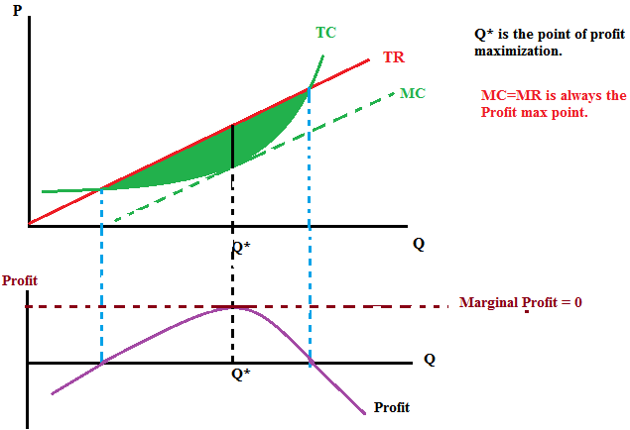
Profit Maximization
Notes:
Note that the output at which profits are maximized is not necessarily the output at which the plant achieves the minimum possible average cost of production. To find out the output which maximizes profit, the firm should use MR=MC=P

Slide 14
Calculating Profits
Quantity | TR P × Q | TC | Profit TR – TC | MR Δ TR ÷ Δ Q | MC Δ TC ÷ Δ Q | Change in Profit MR – MC
0 | $0 | $250 | -$250
10 | 100 | 340 | -240 | $100 | $90 | 10
20 | 200 | 410 | -210 | 100 | 70 | 30
30 | 300 | 460 | -160 | 100 | 50 | 50
40 | 400 | 490 | -90 | 100 | 30 | 70
50 | 500 | 510 | -10 | 100 | 20 | 80
60 | 600 | 540 | 60 | 100 | 30 | 70
70 | 700 | 600 | 100 | 100 | 60 | 40
80 | 800 | 700 | 100 | 100 | 100 | 0
90 | 900 | 950 | -50 | 100 | 250 | -150
100 | 1000 | 1250 | -250 | 100 | 300 | -200
Notes:
First rectangle (blue)
These are just the overall "total" numbers. Notice that the price that Mr. Plow receives for every driveway is P = $10.
TR is just P * Q. The price he receives per driveway, multiplied by the number of driveways he clears.
TC is Mr. Plow keeping track of his total expenses of operating.
Profit is the difference between TR and TC.
Second rectangle (green)
This area shows the marginal analysis looking at MR and MC. Homer should keep producing more (green light!) as long as MR > MC. At this point, each additional driveway cleared will increase his profit, illustrated by the "Change in Profit" column.
Third rectangle (red)
This area shows output levels that are "too high." Homer's MC exceeds his MR for these driveways. Maybe these last additional driveways are in faraway neighborhoods, for example. If Homer clears a driveway where MC > MR, he will decrease his profit.
Fourth rectangle (green)
This row shows the optimal amount of production for Mr. Plow using the marginal analysis. Mr. Plow should produce output (clear driveways) until MR = MC. Profit is maximized at 80 driveways, and he will earn a profit of $100.

Slide 15
Deciding How Much to Produce
Competitive firm is a price taker.
Cannot set his own price, and must charge the price that is determined by overall supply and demand.
Recall
Cost curves (ATC, AVC, and MC) are U-shaped.
In perfect competition, P = MR.
Profits are maximized at the level of output Q where MR = MC.
Notes:
Recall that Mr. Plow is no better, or worse, than his competition, so customers who want their driveways cleared choose the firm with the lowest price. Since the snow removal companies provide the same service, they must charge the price that is determined from the overall supply and demand conditions that regulate the market. As a result, the firm's marginal revenue is constant.
Having noted all this, a graphical analysis is helpful.

Slide 16
Profit Maximization
Notes:
We can use the profit maximizing rule, MR = MC, to identify the most profitable output in a three-step process:
1.Locate the point at which the firm will maximize its profits: MR = MC
2.Look for the profit maximizing output: move down the vertical dashed line to x axis at point Q. Any quantity greater than, or less than, Q would result in lower profits.
3. Determine the average cost of producing Q units. From Q move up along the dashed line until it intersects with the ATC curve. From that point move horizontally until you come to the y axis. This tells us the average cost, C, of making Q units.
Since the MR is the price, and the price is higher than the average cost, the firm makes the profit shown in the green rectangle, which is the visual representation of the profit the firm earns.

Slide 17
Calculating Profit
To find profit, we need to know revenues and costs.
For a perfectly competitive firm, revenues can be found by looking at the price (determined by the market) and the quantity sold.
Costs are determined by the quantity sold.
For the firm,
Intuition: Profit = (units sold) ×(average profit per unit)
Notes:
On the previous slide, we showed the graph.
Profit is shown as the area of a rectangle:
Q is the width of the rectangle (number of units sold).
P – ATC is the height of the rectangle (average profit per unit).

Slide 18

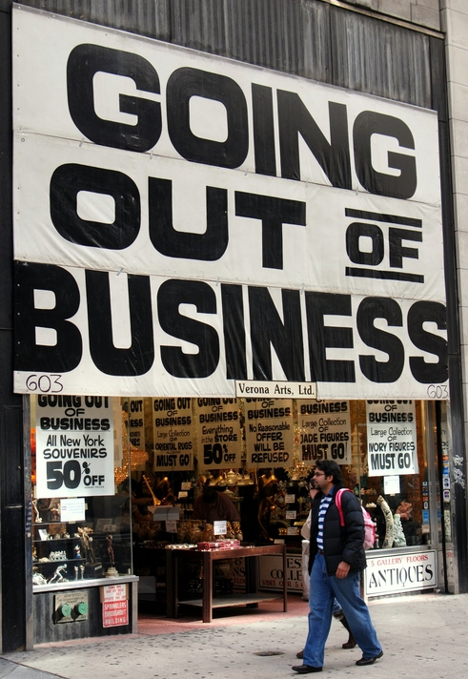
The Decision to Shut Down in the Short Run
Firms can't always make a profit.
Ski resort in summer
Surf shop in winter
Shutting down
Firm will shut down if it cannot cover variable costs in the short-run.
Shutting down is not the same as going out of business and exiting the industry.
Notes:
As another example, many businesses and restaurants in West Yellowstone, Montana, are only open in the winter and summer when many tourists visit Yellowstone National Park. During the off seasons of fall and spring, the establishments shut down.
Shutting down is NOT the same as going out of business.
Shutting down: Firm doesn't open today (or this week). Lights stay off, workers stay home, the assembly line switch doesn't get turned on. Zero output produced. However, if conditions improve (namely, higher prices for output), the option to "turn on" the business again is always possible.
Exiting the industry: We completely get out. We sell all our equipment, workers no longer have jobs (and need to find jobs elsewhere). I'm out of the industry.

Slide 19

Signaling / Shut Down Decision
Profits and losses act as signals to firms.
Signals
Convey information about the profitability of various markets.
Positive profits
A signal of profitability. More firms will enter the industry in the long-run.
Negative profits (losses)
A signal that resources could be doing better elsewhere. Firms might shut down in the short-run and firms will shut down in the long-run.
Notes:
For an example of a signal, think of a stoplight.
Profits act as simple signals telling firms what to do.
The stoplight idea helps give a useful color-coded idea of how firms respond to various conditions!

Slide 20
When to Operate or Shut Down
Notes:
Green = go. Yellow = caution. Red = stop.
If the MR curve is above the minimum point on the ATC curve, the firm will make a profit (shown in green).
If the MR curve is below the minimum point on the ATC curve but above the minimum point on the AVC curve, the firm will operate at a loss (shown in yellow).
If the MR curve is below the minimum point on the AVC curve, the firm will temporarily shut down (shown in red).

Slide 21
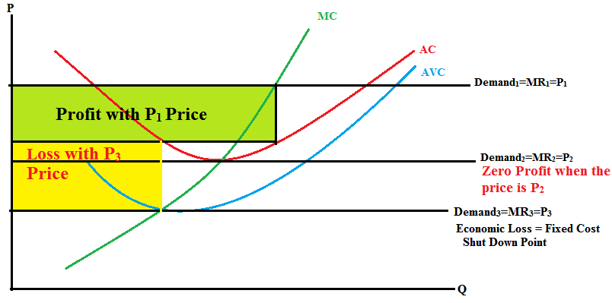
Another Example

Slide 22
Profit and Loss in the Short Run
Condition | Outcome
P > ATC | The firm makes a profit.
ATC > P > AVC | The firm will operate to minimize loss and stays in business.
AVC ≥ P | The firm will shut down but not exit from the market.
Notes:
Yellow area detail:
In this area, you are covering all of your VC (variable costs) and at least SOME of your FC (fixed costs). You are operating at a loss because you can't cover ALL of your expenses. So why are we still producing?
Think about this: Suppose I have FC = $1,000. If I produce Q = 0, I have no revenues, but I also have no VC. Thus, I will lose $1,000 if I shut down and produce Q = 0. However, what if I can cover all of my VC and SOME of my FC? What if I am able to pay $400 of my $1,000 FC? Then, I will ONLY lose $600 for the time period. It's better to lose $600 than to lose $1,000.
I'm still maximizing my profit, it's just that my profit is negative!

Slide 23
Short-Run Supply Curve of Firm
Notes:
In the short run diminishing marginal product causes the firm's costs to rise as the quantity produced increases. This is reflected in the shape of the firm's supply curve, shown in yellow. The supply curve is upward-sloping above the minimum point on the AVC curve. Below the minimum point on the AVC curve—denoted by V on the y axis—the supply curve becomes vertical at a quantity of 0, indicating that a willingness to supply the good does not exist below a price of V. At prices above V, the firm will offer more for sale as the price increases.

Slide 24
Long-Run Supply Curve of Firm
Note that in the long-run all costs are variable. So, as soon as the price falls below the minimum point of ATC, the firm cannot cover its costs and will exit from the market.
Notes:
Any point below the minimum point on the ATC curve, denoted by C on the y axis, the firm will experience a loss. Since, in the long run, firms are free to enter or exit the market, no firm will willingly produce in the market if the price is less than cost (P < C). As a result, no supply exists below C. However, if price is greater than cost (P > C), the Float expects to make a profit and so it will continue to produce. Therefore, profits and losses act as signals for resources to enter or leave an industry.
The firm's long-run supply curve, shown in yellow, is upward-sloping above the minimum point on the ATC curve, which is denoted by denoted by C on the y-axis. The supply curve becomes vertical at a quantity of 0, indicating that a willingness to supply the good does not exist below a price of C. In the long run, a firm that expects price to exceed ATC will continue to operate, since the conditions for making a profit seem favorable. On the other hand, a firm that does not expect price to exceed ATC should cut its losses and exit the industry.

Slide 25
Long-Run Enter/Exit Criteria
Condition | Outcome
P > ATC | The firm makes a profit and enter to market.
P < ATC | The firm makes a negative profit and exit from market.
Notes:
Notice now that there is just one cost curve, the ATC. In the long run, all inputs (capital and labor) are variable so we don't distinguish between fixed and variable costs.
Also, note that there is no yellow area here. In the short run case, we said a firm may temporarily experience a loss. However, realize that no firm can indefinitely sustain losses before going out of business. If conditions are bad (low prices) for long enough, the firm will have exit the industry in the long run.

Slide 26
Short-Run Market Supply
Notes:
Here is the short run market supply curve in a two-firm model consisting of Mr. Plow and the Plow King. At a price of $10, Mr. Plow is willing to clear 8 driveways and the Plow King is willing to clear 20 driveways. When you combine the output of the two firms, you get a total market supply of 28 driveways, seen in the third graph.

Slide 27
Long-Run Market Supply
Note that the long-run supply
indicates the long-run price
in the market .
Notes:
The profit maximizing point of the individual firm in panel (a), MR = MC, is located at the minimum point on the ATC curve. The price (P) that existing firms receive is just enough to cover costs (C), so profits are zero. As a result, new firms have no incentive to enter the market and existing firms have no reason to leave. At all prices above P, firms will earn a profit (the green shaded area) and at all prices below P, firms will experience a loss (the red shaded area). This picture is consistent for all markets with free entry and exit; zero economic profit occurs at only one price and that price is the lowest point of the ATC curve.
At this price the supply curve in panel (b) must be a horizontal line at P. If the price was any higher, firms would enter, supply would increase, and this would force the price back down to P. If the price was any lower, firms would exit, supply would decrease, and this would force the price up to P. Since we know that these adjustments will have time to take place in the long run, the long-run supply curve must also be equal to P in order to satisfy the demand that exists at this price.

Slide 28
Long-Run Market in Equilibrium
Note that the long-run supply
indicates the long-run price
in the market .
Note that in the long-run economic profit is 0.
Notes:
The next three graphs are going to show an adjustment process.
Panel (a) represents an individual firm operating at the minimum point on its ATC curve. In long run equilibrium, all firms are operating as efficiently as possible. Since the price is equal to the average cost of production, economic profits for the firm are zero.
In panel (b) the SR supply curve and the demand curve intersect along the LR supply curve so the market is also in equilibrium. If, for instance, the SR supply curve and demand curve happened to intersect above the LR supply curve, the price would be higher than the minimum point on the ATC curve. This would lead to short run profits and indicate that the market was not in long run equilibrium. The same is true if the SR supply curve and demand curve happened to intersect below the LR supply curve since the price would be lower than the minimum point on the ATC curve. This would lead to short run losses and once again the market would be in long run equilibrium.

Slide 29
Short-Run Adjustment to Demand Decrease
Notes:
Now, a decrease in market demand occurs!
The market demand curve shifts from D₁ to D₂. When demand falls, the equilibrium point moves to point B. The price drops to P₂ and the market output drops to Q₂. The firms in this industry take their price from the market, so the new marginal revenue curve is MR₂ at P₂ in panel (a). Since the firm maximizes profits where MR₂ = MC, the firm will produce an output of q₂. When the output is q₂ the firms costs, C₂, are higher than the price it charges, P₂, so it experiences a loss equal to the pink shaded area in panel (a). In addition, since the firm's output is lower, it is no longer producing at the minimum point on its ATC curve, so the firm is not as efficient as before.

Slide 30
Economic Profits
Why join an industry if you can't maintain long-run positive economic profits?
Remember the difference between accounting and economics profits.
Economics profits
Include opportunity costs.
Zero economic profits means that your opportunity costs are the same as your accounting profits.
Economic Profit = Total Revenue – Total Cost
Economic Profit = Total Revenue – (Explicit Costs + Implicit Costs)
Economic Profit = (Total Revenue – Explicit Cost) – Opportunity Cost
Economic Profit = Accounting Profit – Opportunity Cost
If Economic Profit = 0 , then Accounting Profit = Opportunity Cost
Notes:
In addition, remember that it is possible to have positive accounting profits but NEGATIVE economic profits? What does this mean?
It means that you can cover all of your direct expenses (workers, electricity, rent, etc), but the opportunity cost of doing what you're doing is very big. In other words, you could manage a fast-food restaurant and pay all your bills and make some money, but what if you could be a high-paid financial advisor and make a lot more income? The opportunity cost of your time is very high in that case. You could be making a lot more money elsewhere if you invested your time with a different company.
Or, what if you have a building in the downtown area of a college town? If you run a dry-cleaning business, you are giving up the opportunity to run a bar or night club in the same building. The opportunity cost of not using your capital for other services is large.
What if you're mowing lawns for $10 an hour when you could be tutoring for $20 an hour?

Slide 31
Long-Run Adjustment to Demand Decrease
Notes:
With unfavorable market conditions, some firms leave in the industry!
As firms exit, the market supply contracts from S₁ to S₂ and the market equilibrium moves to point C. At point C, the price rises back to P₁. Market output drops to Q₃ and price returns to P₁. The firms that remain in the market no longer experience a short run loss since M₂ returns to MR₁ and costs fall from C₂ to C₁. The end result is that the firm is once again efficient and economic profits return to zero.

Slide 32
Animated Analysis: Long-Run
Recall that for a competitive industry in the long-run:
If firms are making positive profits, then new firms will enter.
Profits are a signal for the entry of new firms. The industry will expand.
Market supply shifts right → and price will fall until profits are zero.

Slide 33
Animated Analysis: Long-Run
Firm entry caused by positive profits.
Cost, Price
Single Firm
Price
Market
MC
S₁
ATC
S₂
P₂
P₁
D
Q₂
Q₁
Quantity
Quantity
Notes:
"Beyond the Book" Slide
Lecture tip:
Click through to reveal the graph and animation.
Be sure to let the animation play! (Don't click too many times or you'll skip the animation.)

Slide 34
Animated Analysis: Long-Run
Recall that for a competitive industry in the long run:
If firms are making negative profits, then existing firms will exit.
Losses are a signal for the exiting of firms. The industry will contract (shrink).
Market supply shifts left ← and price will rise until profits are zero.

Slide 35
Animated Analysis: Long-Run
Firm exit caused by negative profits.
Cost, Price
MC
Single Firm
Price
Market
ATC
S₁
S₂
P₂
P₁
D
Q₁
Q₂
Quantity
Quantity
Notes:
"Beyond the Book" Slide
Lecture tip:
Click through to reveal the graph and animation.
Be sure to let the animation play! (Don't click too many times or you'll skip the animation).

Slide 36
Animated Analysis: Long-Run Summary
Free entry means that anyone can enter the industry in response to profit opportunities.
Thus, if the industry is profitable, new firms will enter. This increases supply and decreases prices, lowering profits.
If the industry is experiencing losses, firms will exit. This decreases supply and increases prices, increasing profits for remaining firms.
As long as firms are entering and exiting, we are not in long-run equilibrium.
In perfect competition, we move toward zero economic profit over time.

Slide 37
Practice What You Know Short Run or Long Run?
Answer the following questions by making sounds for the following answers:
Short-run: clap
Long-run: snap
Either/both: stomp your feet

Slide 38
Practice What You Know Short Run or Long Run?
Short-run: clap
Long-run: snap
Either/both: stomp your feet
Dave's Bar & Grill is producing output, but Dave is doing so with a fixed level of capital.
Short-run—capital is fixed in the short-run.

Slide 39
Practice What You Know Short Run or Long Run?
Short-run: clap
Long-run: snap
Either/both: stomp your feet
Jaime owns a firm in a perfectly competitive industry. She is making positive economic profits.
Short-run—in PC industries, profits can be positive in the SR, but will be zero in long-run equilibrium.

Slide 40
Practice What You Know Short Run or Long Run?
Short-run: clap
Long-run: snap
Either/both: stomp your feet
Pizza Barn builds a new restaurant.
Long-run—changing levels of capital.

Slide 41
Practice What You Know Short Run or Long Run?
Short-run: clap
Long-run: snap
Either/both: stomp your feet
A new competitor enters the industry.
Long-run—entering or exiting involves changing levels of capital.

Slide 42
Practice What You Know Short Run or Long Run?
Short-run: clap
Long-run: snap
Either/both: stomp your feet
Kyle is producing output, and can cover his VC, but not his FC expenses.
Short-run—in the long run we don't have FC expenses.

Slide 43
Practice What You Know Short Run or Long Run?
Short-run: clap
Long-run: snap
Either/both: stomp your feet
Eric is a farmer. Given the price of corn, he chooses how much to produce.
Either/both—a profit maximizing firm always will choose the optimal Q* output in both the short-run and long-run.

Slide 44
Practice What You Know Short Run or Long Run?
Short-run: clap
Long-run: snap
Either/both: stomp your feet
Mark fires some employees for shirking.
Either/both—changing labor inputs can be done in the short or long-run. Labor is always variable.

Slide 45
Practice What You Know Short Run or Long Run?
Short-run: clap
Long-run: snap
Either/both: stomp your feet
JoAnn enters the coffee shop industry in hopes of making a profit.
Long-run—firm entry and exit occurs in the long run.

Slide 46
Practice What You Know Short Run or Long Run?
Short-run: clap
Long-run: snap
Either/both: stomp your feet
Kerry examines his fixed costs and thinks they are too high.
Short-run—fixed costs are associated with fixed inputs in the short-run.

Slide 47
Practice What You Know Short Run or Long Run?
Short-run: clap
Long-run: snap
Either/both: stomp your feet
Fatty's Rib restaurant experiences higher costs and lower profits because the price of BBQ sauce increases.
Either/both—an input price could change at any time, affecting a firm's profits.

Slide 48
Conclusion
Profits and losses act as signals in a perfectly competitive market.
Profits = green light. This is a good industry to enter.
Losses = red light. Time to get out of this industry.
Producers can survive in the long run by creating goods that consumers value.

Slide 49
Summary
For perfect competition to exist, two factors must be in place:
A competitive market
Easy entry and exit from the market
A price taker has no control over the price it pays, or receives, in the market.
A firm that maximizes profits will expand output (Q) until MR = MC = P.
Notes:
The profit maximizing rule is a condition for stopping production at the point where profit opportunities no longer exist.

Slide 50
Summary
The firm should shut down if the price it receives does not cover its average variable costs. Firms may temporarily shut down in hopes of better days ahead.
A firm that does not expect future profits will go out of business.
The MC curve is the firm's supply curve as long as the firm is operating.
Notes:
Since variable costs are only incurred when operating, if a business can make enough to cover its variable costs in the short run it will choose to operate.

Slide 51
Summary
Profits and losses act as signals for firms to enter or to leave an industry.
As a result, perfectly competitive markets drive economic profit to zero in the long-run.
If there are positive economic profits
Other firms will enter and erode the profits away.
If there are negative economic profits
Existing firms will exit (go out of business), and price will rise until profits are zero.

Slide 52
Practice What You Know
Steve runs a competitive sandwich shop. Right now, he is producing output at a level where MR > MC. To increase his profits, Steve should
try to use more capital in his production.
try to use more labor in his production.
produce less output.
produce more output.
Notes:
Correct answer: D
The marginal analysis says to produce until MR = MC. If MR > MC, it means you could be making more profits by making more sandwiches.

Slide 53
Practice What You Know
If a competitive industry is making positive economic profits, what will eventually happen in this industry?
The market supply will shift to the left.
The market supply will shift to the right.
The market demand will shift to the left.
The market demand will shift to the right.
Notes:
Correct answer: B
In a competitive market, positive profits will signal more firms to enter the industry. This will shift market supply to the right. Eventually, the price will fall and profits will return to zero.

Slide 54
Practice What You Know
Suppose a competitive firm is faced with a price in the short-run that is below ATC but above AVC. In the short-run, this firm should
shut down.
exit the industry.
raise the price of the good.
produce at the output level where MR = MC.
Notes:
Correct answer: D
Here, the firm can cover ALL VC, and PART of FC. Better to cover part of your FC than NONE of your FC.
Note that a competitive firm cannot raise the price because of the existence of perfect substitutes.

Slide 55
Practice What You Know
What do you suppose is one of the main reasons that competitive firms all earn zero economic profits in the long-run?
Each firm has a lot of market power.
Firms all want to earn zero profits.
Free entry and exit in the industry.
The cost curves are U-shaped.
Notes:
Correct answer: C
Free entry and exit in a competitive industry allows capital to flow where profit is available. In a profitable industry, more firms enter and will erode profits to zero. If new firms could not enter because of entry barriers, existing firms could earn long run profits.

Slide 56
Practice What You Know
A competitive firm will shut down and produce output level Q = 0 if
P < min (ATC)
min (AVC) < P < min (ATC)
P ≤ min (AVC)
P = MR
Notes:
Correct answer: C
This answer is the "shut down point." The minimum of the AVC gives us the boundary price of when it's best to produce or shut down. If you can't even cover your variable expenses, it is best to shut down.

Slide 57
Sources
"Principles of Economics with Smartwork Access (ISBN: 978-0-26314-5), 1st Edition, 2013" by Mateer and Coppock
"Economics: Custom Edition for NCSU (ISBN: 9781937435202" by David Hyman

